Slide 1



TechHacks 3.0
By CHITKARA UNIVERSITY
IDEA SUBMISSION
Presented by : Team Sapiens

Slide 2







TRACK - Open Innovation
Solution based on the domain of HEALTHCARE

Slide 3

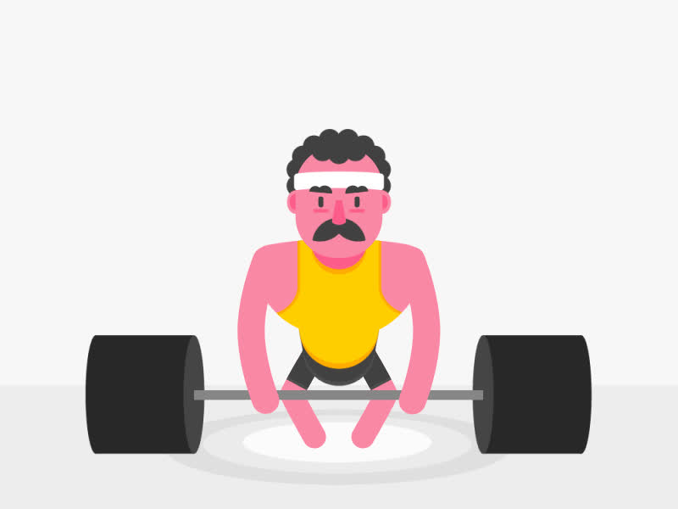

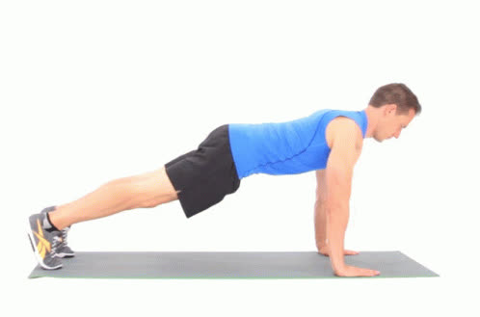
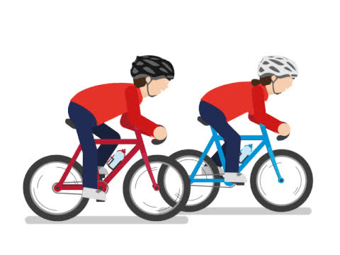

PROBLEM STATEMENT
To develop a web-based application for performing regular physical activity that helps sharpen the brain, help manages weight, reduces the risk of diseases, strengthens bones and muscles, makes the body flexible, and improves efficiency to do regular day-to-day chores.

Slide 4


Solution
HOW???
ABHYAAS
I don't sweat, I sparkle
It is a web application which is having various programs such as strength training, cardio training, yoga, and a diet plan for having a balanced diet to lead a healthy lifestyle.
It is a B2C model through which trainers from all over the country are connected and users can take services from them.
It also has a Plans section through which registered users would be able to buy a plan for various exercises according to his/her budget which is going to mutually benefit the user as well as the trainers.

Slide 5

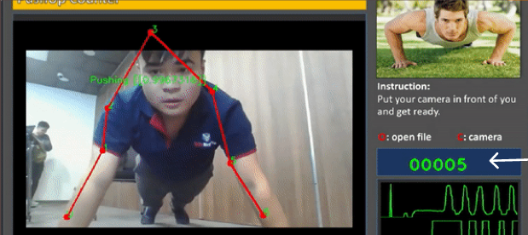
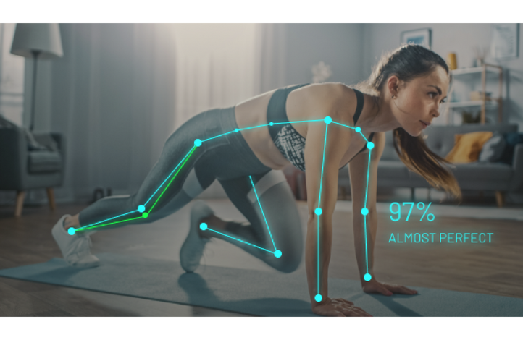

Technology used
Push up Counter
Machine learning
Open CV is used to count pushups or situps of a person

Slide 6
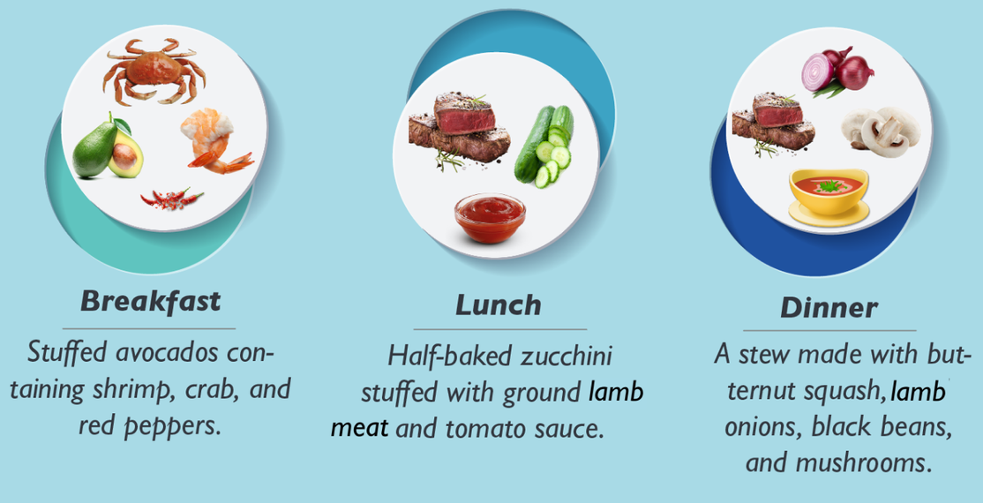
Diet - Plan
Again machine learning is used to suggest the diet according to age and weight.

Slide 7
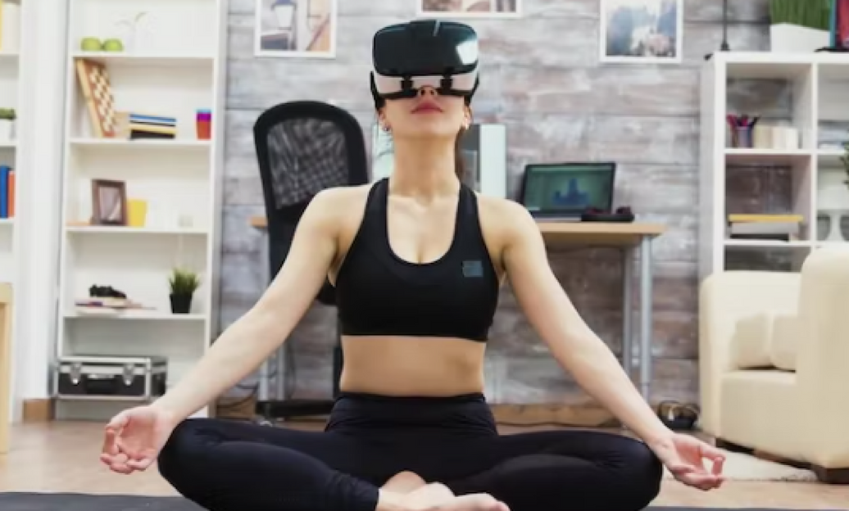
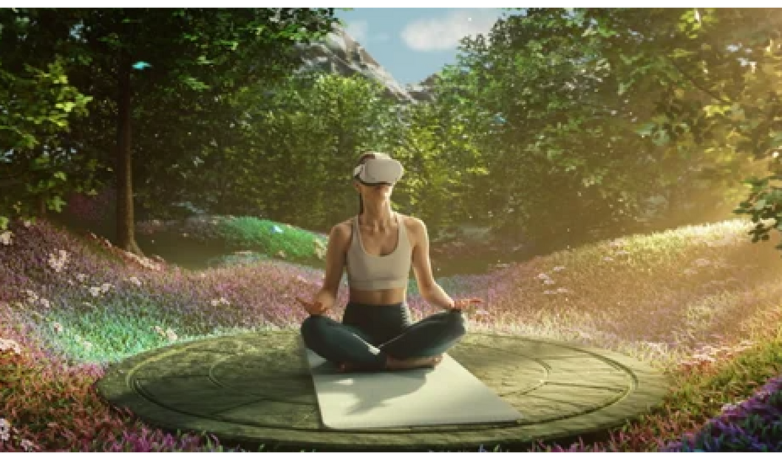
AR-VR
AR - VR is used in virtual yoga and meditation

Slide 8
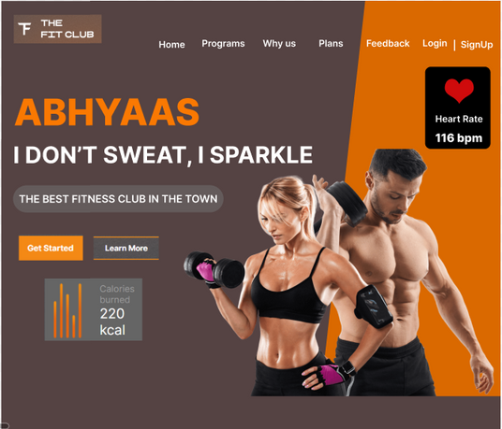
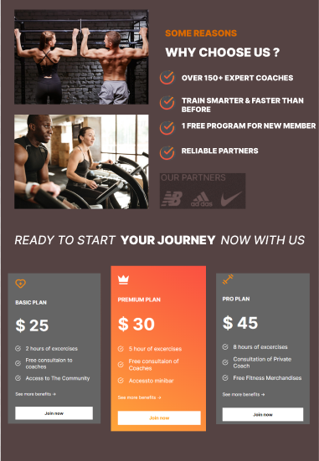
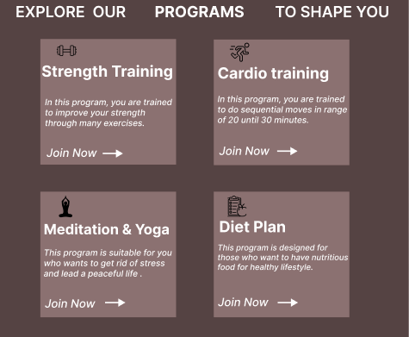
PROTOTYPE
HOW???
The first page contains various programs which offer various exercises, the option of the plan which the user can buy, and some unique features of the application

Slide 9
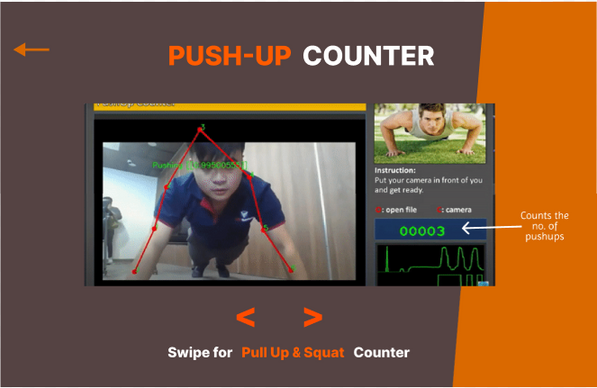
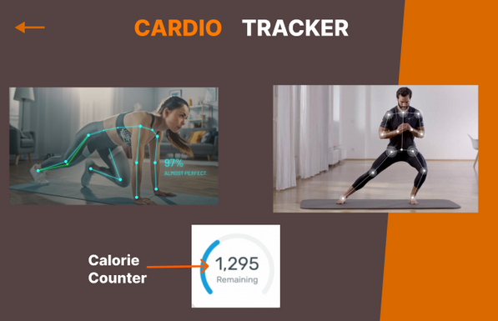
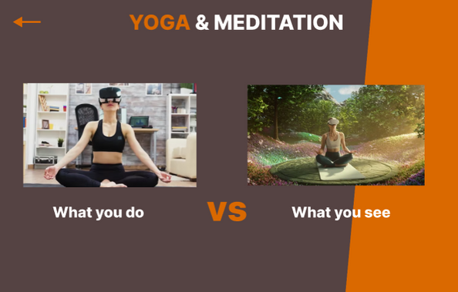
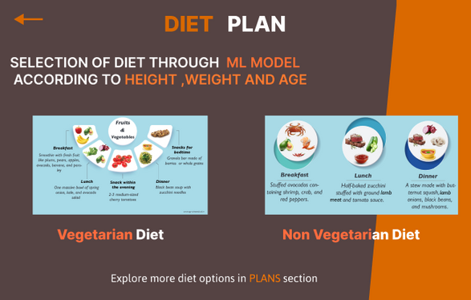
PROTOTYPE
HOW???
After clicking the strength training section, the user can count his/her pushups.
After clicking the cardio training section, the user can count the burned calories.
After clicking the Yoga section, user can meditate in the lap of nature while sitting at home using AR-VR.
The diet plan section gives the suitable balanced diet according to the user's exercise.

Slide 10

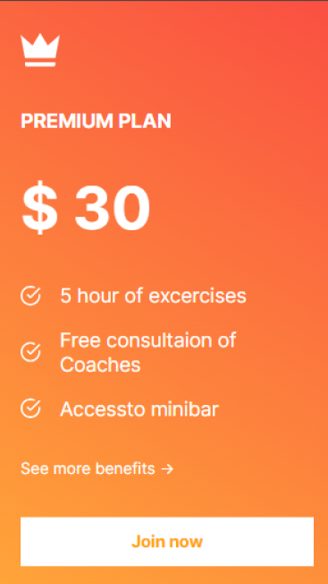
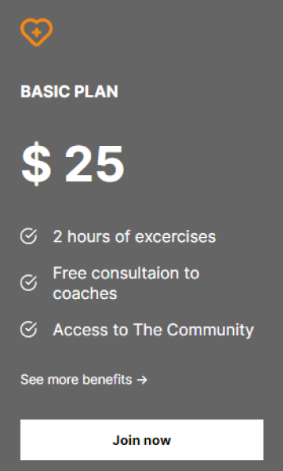
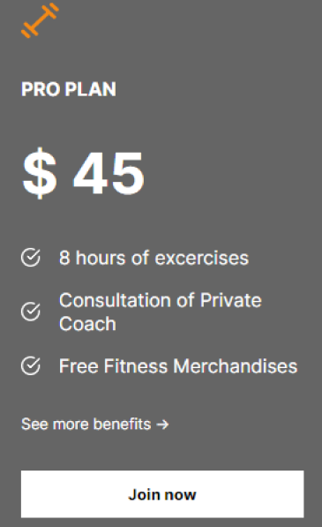
Business Model
•The Subscription Model will be our main revenue model. And the services rendered by us will be made available via monthly based subscription Basis.
•Google Ad sense will be implemented according to user preferences so that a major portion of revenue can be generated.

Slide 11
Future Scope
•In the Future we will focus on the Reach of the product. The main goal will be to set up a refer and earn system so that the app will gain popularity of the Application.
•Other features that we're planning to add in the Future are -
Physical Rehabilitation, Telemedicine, Medical Training.
•We will also introduce a Reward System in which the user will get rewards in the form of coins which the user can use to buy goodies and other merchandise , if the user will be successful in completing one month streak and achieves the desired goals.
•Covid-19 pandemic has significantly contributed to the augmented reality and virtual reality technology market and we'll also contribute to society with this health and mental fitness web app.

Slide 12
Benefits for Society
Get Free Health & Fitness Tips in the form of articles, daily notifications, calendar updates etc.
Users can monitor and Track the Progress which helps to motivate people.
People can work out anywhere at any time without having any bulky setup of the gym.
People can meditate according to their choice of place which helps them focus more and provides them peace of mind in such stressful times.
People can track all the food intake easily and maintain a balanced diet for healthy lifestyle.

Slide 13
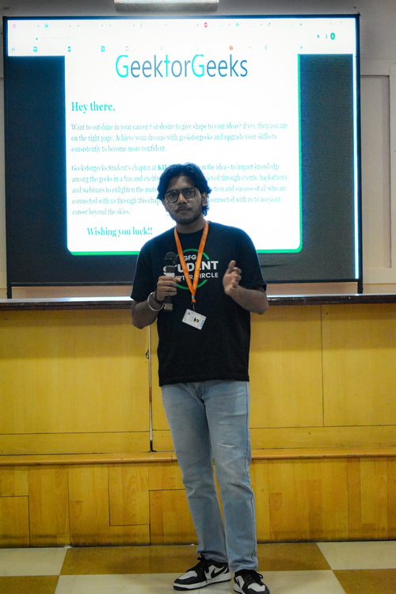
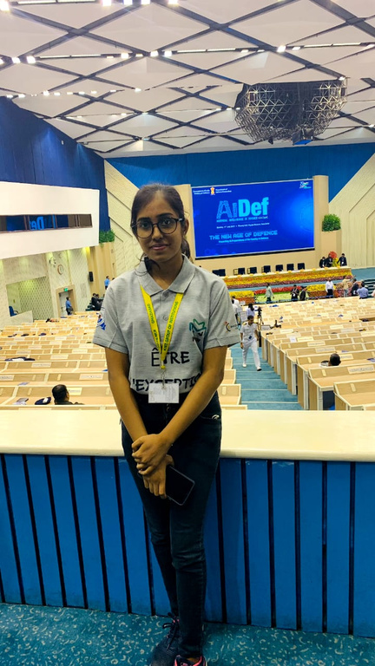
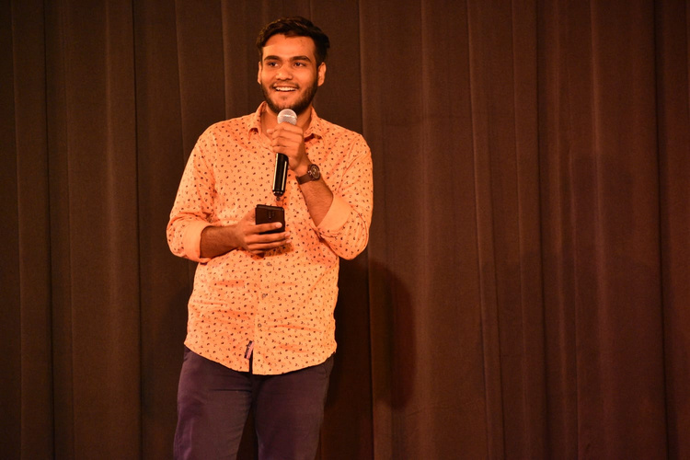
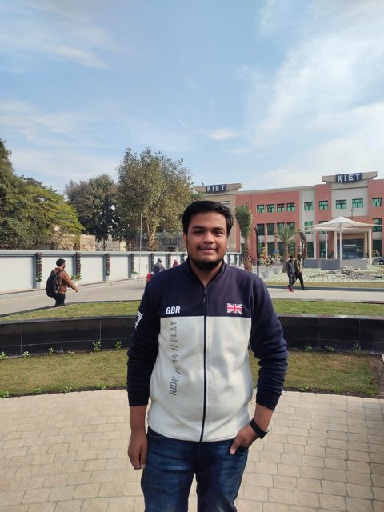
Meet Our TEAM MEMBERS
Ayush Tyagi
Bhoomika Saxena
Chhayank Tyagi
Hanu Agarwal
CS 3rd Year
CS 3rd Year
CS 3rd Year
CS 3rd Year

Slide 14
THANK YOU

